Slide 1

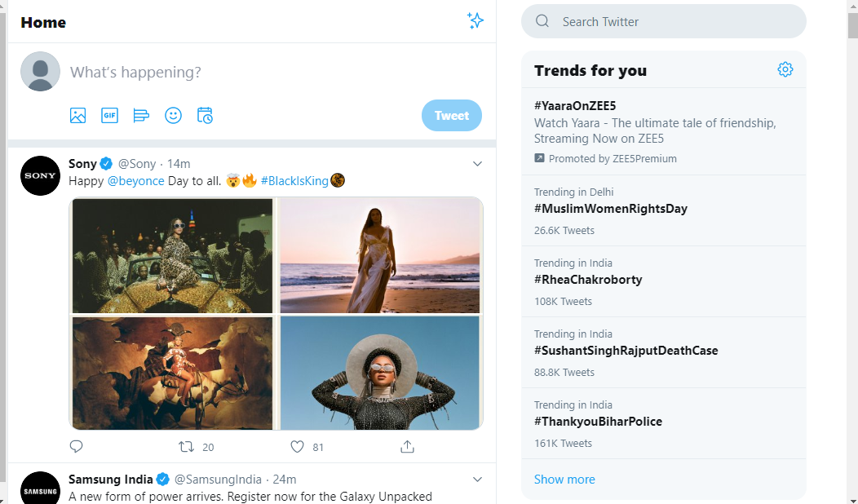


Twitter Sentiment Analysis
Submitted by:
Name - Tanya Goel
Enrollment number - 36614802718
Group - 5C7

Slide 2
Problem Statement
To perform sentiment analysis on the tweets collected manually which mention one of the featured artists of Sony Music International

Slide 3
Motivation
To allow the company to analyse the social media presence and influence of their featured artists
To allow the company to analyse how people reciprocate towards the song released by their featured artists

Slide 4
Steps Timeline
Data Collection
Data Filtering
Table Preprocessing
Sentiment Analysis
Exploratory Data Analysis (EDA)
Word Cloud

Slide 5


Data Collection
Twitter API keys
Script for continuous data collection
Query creation (‘@DojaCat’, ‘#DojaCat’, ‘#dojacat’, ‘#doja_cat’, etc)
Run script to collect data rigorously
Total tweets collected = 6,218

Slide 6



Data Filtering
Removal of duplicate tweets
Unique tweets identification
Unique users identification
Grouping of data on the basis of user id and tweet id
Total tweets after filtering = 211

Slide 7
Table Preprocessing
Calculated max followers count of each user
Calculated max retweet count of each user
Addition of sentiment and sentiment score of each tweet as per words used in it (positive, negative, neutral)
Removal of unnecessary columns and addition of new required columns

Slide 8
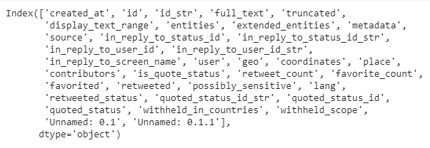
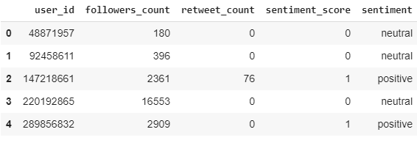
Before:
After:

Slide 9
Statistics
Tweets collected (with duplicates) | 6,218
Tweets (without duplicates) | 211
Queries used | 5
Average followers count of all users | 1143.261438
Average retweet count of all users | 574.437908

Slide 10



Sentiment Analysis
Cleaning of tweet text using regular expression to remove ‘@, https://,#’,etc
Translation of tweet texts of other languages to English for sentiment analysis.
Analysis of tweet text.
RESULT (out of 211 tweets):
Neutral = 49 %
Positive = 38.6 %
Negative = 12.4 %

Slide 11
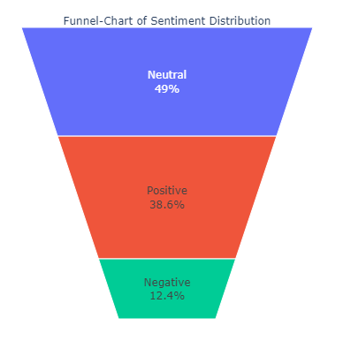
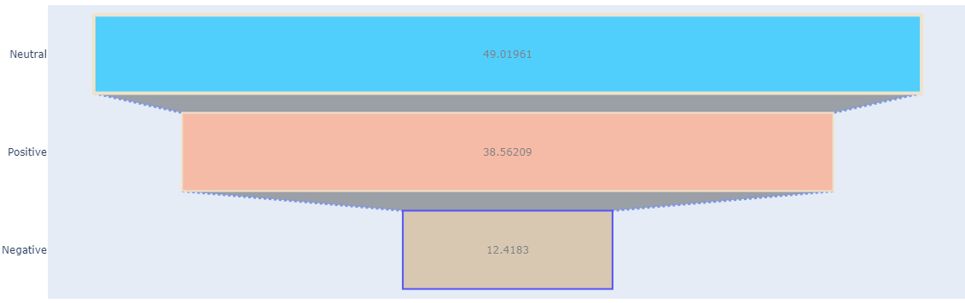

Slide 12


Exploratory Data Analysis
Graph plotting on the data collected
Multiple graphs plotting using different parameters

Slide 13
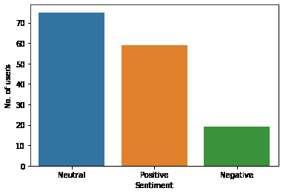

Slide 14
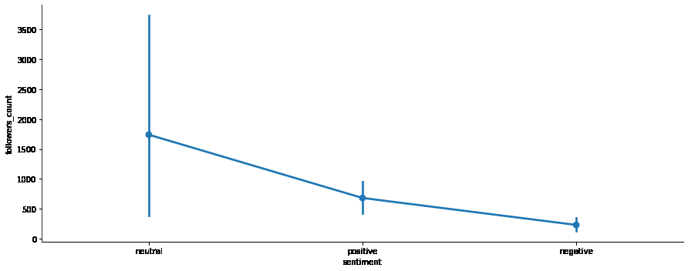

Slide 15
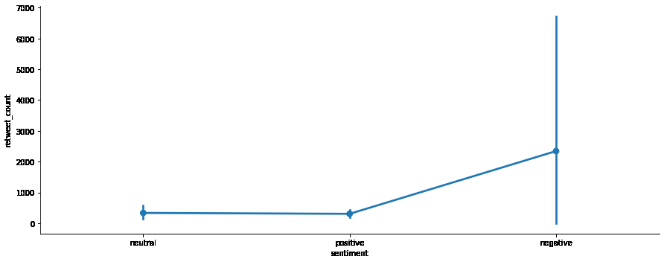

Slide 16
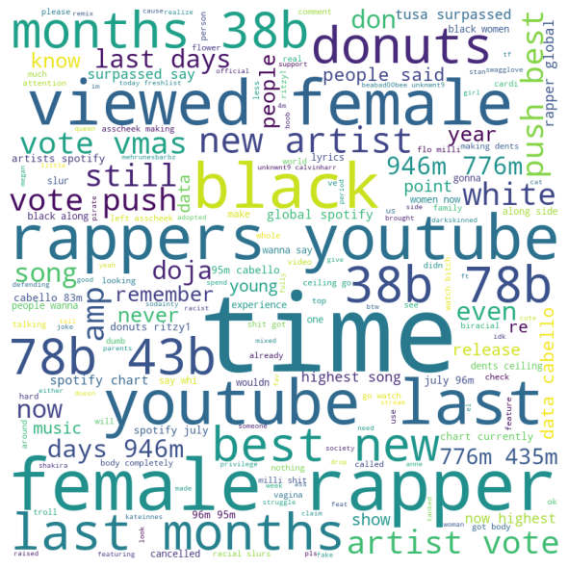
DATA CLOUD

Slide 17
Future Scope
Such analysis can be performed on other featured artists of the Sony Music Entertainment company.
We can perform a similar Twitter Sentiment Analysis on the songs released by artists featured by Sony Music Entertainment to analyze their reach and people's reaction towards those songs.

Slide 18
References
[1] AH Infotech (www.ahinfotechusa.com)
[2] Sony Music Entertainment (www.sonymusic.com)
[2] GeeksForGeeks (www.geeksforgeeks.com)
[3] Kaggle (www.kaggle.com)
[4] StackOverFlow (www.stackoverflow.com)
[5] Wikipedia
[6] W3 Schools (www.w3schools.com)

Slide 19
Thank You!

